Slide 1
Directed Diffusion:
A Scalable and Robust Communication Paradigm for Sensor Networks
Presented by Barath Raghavan

Slide 2
Motivation
Properties of Sensor Networks
  Data centric, but not node centric
  Have no notion of central authority
  Are often resource constrained
Nodes are tied to physical locations, but:
  They may not know the topology
  They may fail or move arbitrarily
Problem: How can we get data from the sensors?

Slide 3
Directed Diffusion
Data centric – nodes are unimportant
Request driven:
  Sinks place requests as interests
  Sources are eventually found and satisfy interests
  Intermediate nodes route data toward sinks
Localized repair and reinforcement
Multi-path delivery for multiple sources, sinks, and queries

Slide 4
Motivating Example
Sensor nodes are monitoring a flat space for animals
We are interested in receiving data for all 4-legged creatures seen in a rectangle
We want to specify the data rate

Slide 5
Interest and Event Naming
Query/interest:
  Type=four-legged animal
  Interval=20ms (event data rate)
  Duration=10 seconds (time to cache)
  Rect=[-100, 100, 200, 400]
Reply:
  Type=four-legged animal
  Instance = elephant
  Location = [125, 220]
  Intensity = 0.6
  Confidence = 0.85
  Timestamp = 01:20:40
Attribute-Value pairs, no advanced naming scheme

Slide 6
Diffusion (High Level)
Sinks broadcast interest to neighbors
Interests are cached by neighbors
Gradients are set up pointing back to where interests came from at low data rate
Once a source receives an interest, it routes measurements along gradients

Slide 7
Directed Diffusion (Gradients)
Gradients from Source (S) to Sink (N) are initially small
Increased during reinforcement
S
N

Slide 8
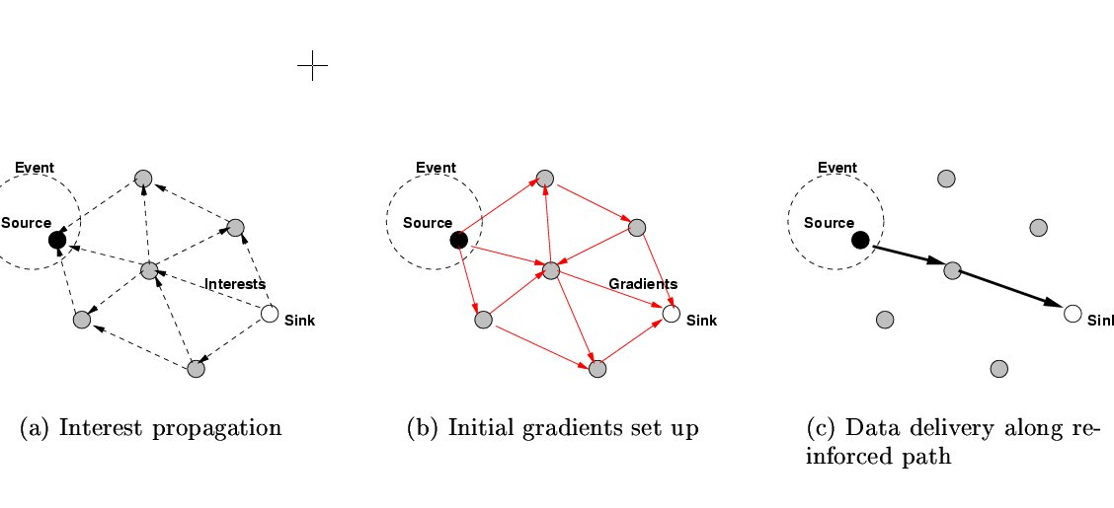
Example

Slide 9
Directed Diffusion (Data)
Sensors match signature waveforms from codebook against observations
Sensors match data against interest cache, compute highest event rate request from all gradients, and (re) sample events at this rate
Receiving node:
  Finds matching entry in interest cache, no match – silent drop
  Checks and updates data cache (loop prevention, aggregation)
  Retrieve all gradients, and resend message, doing frequency conversion if necessasry

Slide 10
Directed Diffusion (Reinforcement)
Reinforcement:
  Data-driven rules unseen msg. from neighbor=>resend original with smaller interval
  This neighbor, in turn, reinforces upstream nodes
  Local rule for this paper: empirically minimize delay, other rules possible
  Passive reinforcement handling (timeout) or active (weights)
Multiple sources+reinforcement
  Works in some cases, open for further exploration
Multiple sinks: Exploit prior setup (i.e., use cache)
Intermediate nodes use reinforcement for local repair
  Cascading reinforcement discoveries from upstream can be a problem; one soln: interpolate requests to preserve status-quo

Slide 11
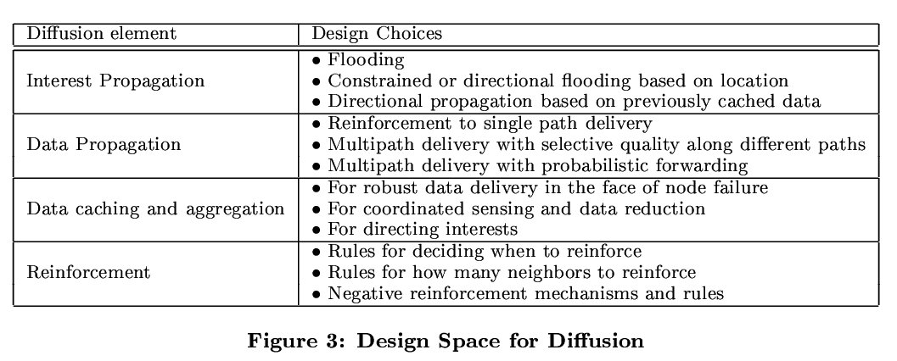
Design Considerations

Slide 12
Claims
Allows nodes to propagate data in the absence of interests
Finds empirically best performing path
Better performance than ad-hoc protocols

Slide 13
Evaluation
ns2 simulation
Modified 802.11 MAC for energy use calc.
Comparison against flooding and omniscient multicast
Experiment with node failure
Did not overload system
Standard random node placement (but only 3 hops across entire topology)

Slide 14
Metrics
Average dissipated energy
  Ratio of total energy expended per node to number of distinct events received at sink
  Measures average work budget
Average delay
  Average one-way latency between event transmission and reception at sink
  Measures temporal accuracy of location estimates
Both measured as functions of network size

Slide 15
Topology
50-250 nodes in 50 node increments
Avg. Node density constant with network size
Square of 160m, radio range of 40m
5 sources, 5 sinks uniformly distributed
1.6Mbps 802.11 MAC
  Not realistic (reliable transmission, RTS/CTS, high power, idle power ~ receive power)
  Set idle power to 10% of receive power, 5% of transmit power

Slide 16
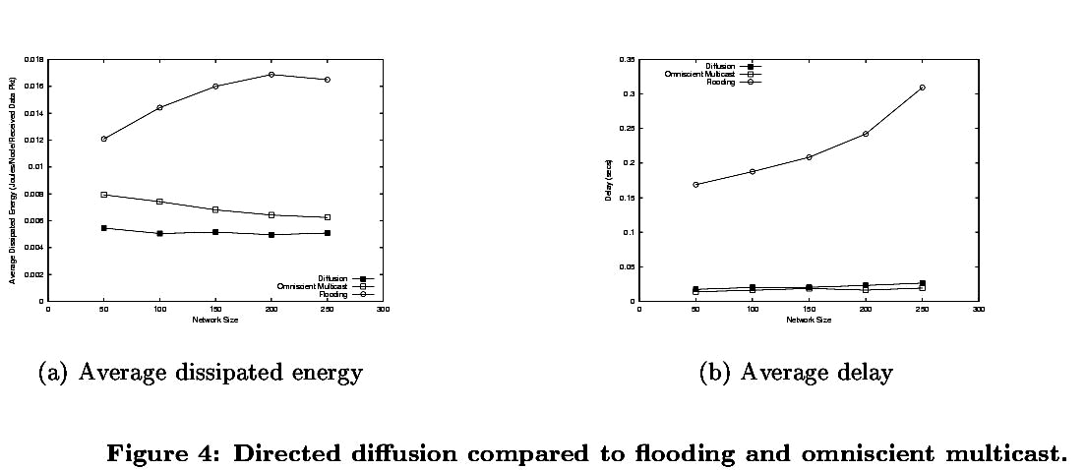
Sim: Average energy and delay

Slide 17
Sim: Average energy and delay
Average delay is misleading
Directed Diffusion is better than Omniscient Multicast!?
  Omniscient multicast sends duplicate messages over the same paths
  Topology has little path diversity
  Why not suppress messages with Omniscient Multicast just as in Directed Diffusion?
Didn’t show synchronization effects of reinforcement

Slide 18
Sim: Failures
Dynamic failures (no settling time), adverse network conditions (10-20% failure at any time)
Each source sends different signals
<20% delay increase, fairly robust
Energy efficiency improves:
  Reinforcement maintains adequate number of high quality paths
  Should it be doing that in the first place?

Slide 19
Analysis
Energy gains are dependent on 802.11 energy assumptions
Can the network always deliver at an interest’s requested rate?
The capacity of such networks is small – how does it fare during overload?
Does reinforcement actually work?
Can low timeouts cause loops in large sensor networks?

Slide 20
Conclusions
Directed Diffusion provides a data-centric communication protocol for sensor sources and sinks
Its gains due to aggregation and duplicate suppression may make it more viable than ad-hoc routing in sensor networks
Its performance needs more extensive evaluation before strong claims can be made

